Slide 1
Who Am I?
Interpreting Images

Slide 2
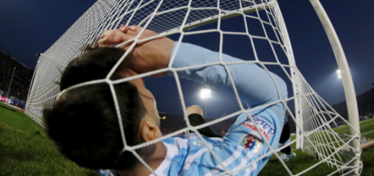
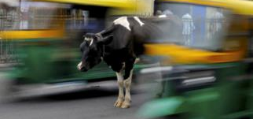
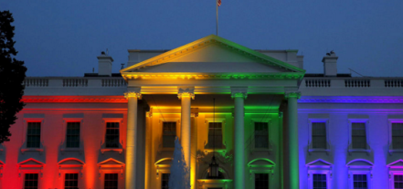
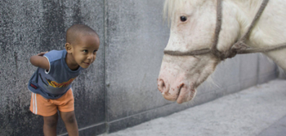
You and I are surrounded by images of all sorts – photographs, drawings, advertisements – each of them, like a piece of writing, provides us with information.
This lesson is about how to ‘read’ images.
An artist or photographer when creating an image selects what to include in the piece, what to provide detail around, what to exclude – you get the idea.
Take a look at these recent popular images from Instagram; what story do you think the artist is trying to create? What message or feeling are the artists trying to create and communicate?

Slide 3
Analyzing Images - A strategy and process for reading images is used by historians, artists and curators. It is a three step process to fully evaluate what message, story and emotion an artist is creating with an image.
The steps are done in order.
Describe - What
Analyze - How
Reflect - Why

Slide 4
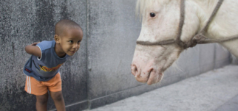
Describe – without making any judgments, look carefully at the image and consider how and what parts of the event or item the artist has chosen to record by asking yourself questions, such as those below?
What clothing is being worn?
What is the pose – ie. playful, formal, casual?
What signs are their of occupation or social class?
Where are the people located in the picture?
What else is in the picture besides people? How are they portrayed in their pose?
Where is the artist standing when creating the image? How much information does the artist provide with background?

Slide 5

Analyze –think what the artist’s reasons were for including the images, details and focus. Ask yourself questions such as those below:
What does the clothing indicate about the person (people)? What about their posture or pose? Facial expression?
If an animal is in the picture, what might it symbolize?
Why do you think the artist choose to add more detail to some areas and people than others? Why are people and things placed where they are?
Why did the artist choose the view they created the picture from (i.e. why not from another angle or overhead?)

Slide 6
Reflect – Now using the information you have gathered and analyzed, think about what story the artist is trying to tell you about the event. Consider the following questions:
What story do you think the artist is trying to tell about the event? What does the artist want you to understand about the object, event or people?
How does the image make you feel about the object, event and people portrayed? Do you think the artist wanted you to feel this way?
What parts of the event do you think the artist feels is most important to the viewer?

